Slide 1
C# Language
Design Patterns
Why?
What are Design Patterns
Classification
OMT – UML
Software Design Principles
SOLID Principles
Design Patterns
Corso C#

Slide 2
C# Language
Books
Agile Software Development: Principles, Patterns, and Practices by Robert Martin
Design Patterns: Elements of Reusable Object-Oriented Software by Erich Gamma, Richard Helm, Ralph Johnson and John Vlissides (GoF)
Corso C#

Slide 3
Why?
Why should you learn patterns?
you might manage to work as a programmer for many years without knowing about a single pattern. A lot of people do just that. Even in that case, though, you might be implementing some patterns without even knowing it. So why would you spend time learning them?
Design Patterns are a toolkit of tried and tested solutions to common problems in software design even if you never encounter these problems, knowing patterns is still useful because it teaches you how to solve all sorts of problems using principles of object-oriented design
Design Patterns define a common language that you and your teammates can use to communicate more efficiently. You can say, “Oh, just use a Singleton for that,” and everyone will understand the idea behind your suggestion. No need to explain what a singleton is if you know the pattern and its name.ì
Corso C#

Slide 4
What are Design Patterns
Criticism of patterns
usually the need for patterns arises when people choose a programming language or a technology that lacks the necessary level of abstraction i.e., the Strategy Pattern can be implemented with a simple anonymous (lambda) function in most modern programming languages.
patterns try to systematize approaches that are already widely used this unification is viewed by many as a dogma, and they implement patterns “to the letter”, without adapting them to the context of their project
a problem that haunts many novices who have just familiarized themselves with patterns is that, having learned about patterns, they try to apply them everywhere, even in situations where simpler code would do just fine: if all you have is a hammer, everything looks like a nail
Corso C#

Slide 5
What are Design Patterns
What are Design Patterns?
Design Patterns are typical solutions to commonly occurring problems in software design. They are like pre-made blueprints that you can customize to solve a recurring design problem in your code
you can follow the pattern details and implement a solution that suits the realities of your own program
Corso C#

Slide 6
What are Design Patterns
What are not Design Patterns?
you can’t just find a pattern and copy it into your program, the way you can with off-the-shelf functions or libraries
the pattern is not a specific piece of code, but a general concept for solving a particular problem
Patterns are often confused with algorithms, because both concepts describe typical solutions to some known problems While an algorithm always defines a clear set of actions that can achieve some goal, a pattern is a more high-level description of a solution
the code of the same pattern applied to two different programs may be different
Corso C#

Slide 7
What are Design Patterns
Four essential elements
Pattern’s four essential elements
Pattern name
Problem
Solution
Consequences
Corso C#

Slide 8
What are Design Patterns
Four essential elements
Pattern Name
is a handle we can use to describe a design problem, its solutions, and consequences in a word or two
naming a pattern immediately increases our design vocabulary
it lets us design at a higher level of abstraction
having a vocabulary for patterns lets us talk about them with our colleagues, in our documentation, and even to ourselves
it makes it easier to think about designs and to communicate them and their trade-offs to others
Corso C#

Slide 9
What are Design Patterns
Four essential elements
Problem
describes when to apply the pattern
it explains the problem and its context
it might describe specific design problems such as how to represent algorithms as objects
it might describe class or object structures that are symptomatic of an inflexible design
sometimes the problem will include a list of conditions that must be met before it makes sense to apply the pattern
Corso C#

Slide 10
What are Design Patterns
Four essential elements
Solution
describes the elements that make up the design, their relationships, responsibilities, and collaborations
the solution doesn’t describe a particular concrete design or implementation, because a pattern is like a template that can be applied in many different situations
instead, the pattern provides an abstract description of a design problem and how a general arrangement of elements (classes and objects in our case) solves it
Corso C#

Slide 11
What are Design Patterns
Four essential elements
Consequences
are the results and trade-offs of applying the pattern
though consequences are often unvoiced when we describe design decisions, they are critical for evaluating design alternatives and for understanding the costs and benefits of applying the pattern
the consequences for software often concern space and time trade-offs
they may address language and implementation issues as well since reuse is often a factor in object-oriented design, the consequences of a pattern include its impact on a system’s flexibility, extensibility, or portability. Listing these consequences explicitly helps you understand and evaluate them
Corso C#

Slide 12
Classification
Classification
 |  | Purpose
 |  | Creational | Structural | Behavioural
Scope | Class | Factory Method | Adapter (class) | Interpreter Template Method
 | Object | Abstract Factory Builder Prototype Singleton | Adapter (object) Bridge Composite Decorator Facade Flyweight Proxy | Chain of Responsibility Command Iterator Mediator Memento Observer State Strategy Visitor
Corso C#

Slide 13
Classification
Classification
we classify design patterns by two criteria:
purpose, reflects what a pattern does - patterns can have either creational, structural, or behavioral purpose
Creational - concern the process of object creation, provide object creation mechanisms that increase flexibility and reuse of existing code
Structural - deal with the composition of classes or objects, explain how to assemble objects and classes into larger structures, while keeping these structures flexible and efficient
Behavioral - characterize the ways in which classes or objects interact and distribute responsibility, take care of effective communication and the assignment of responsibilities between objects
scope, specifies whether the pattern applies primarily to classes or to objects
Class - deal with relationships between classes and their subclasses these relationships are established through inheritance, so they are static—fixed at compile-time
Object - deal with object relationships, which can be changed at run-time and are more dynamic
Corso C#

Slide 14
OMT – UML
Object Modeling Technique vs Unified Modeling Language
OMT (1991) is a predecessor of the Unified Modeling Language (UML) (1997)
many OMT modeling elements are common to UML
they are a graphical language that give a standard way to write a software system's blueprint
they help to visualize, specify, construct, and document the artifacts of an object-oriented system
they are used to depict the structures and the relationships in a complex system
NOTE: a new standard is coming, called Systems Modeling Language (SysML), is defined as an extension of a subset of the Unified Modeling Language (UML) using UML2's profile mechanism
Corso C#

Slide 15
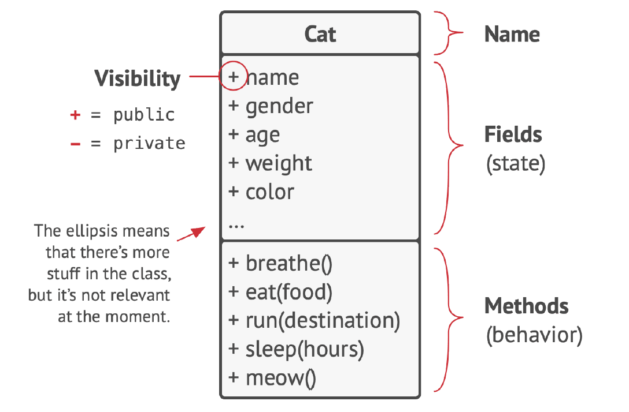
OMT – UML
UML Class
we have a cat named Rock
Rock is an object, an instance
of the Cat class
every cat has a lot of standard attributes:
name, sex, age, weight, color, favorite food, etc. these are the class’s fields
all cats also behave similarly: they breathe, eat, run, sleep and
Meow
these are the class’s methods
collectively, fields and
methods can be referenced as the members of their class
Corso C#

Slide 16
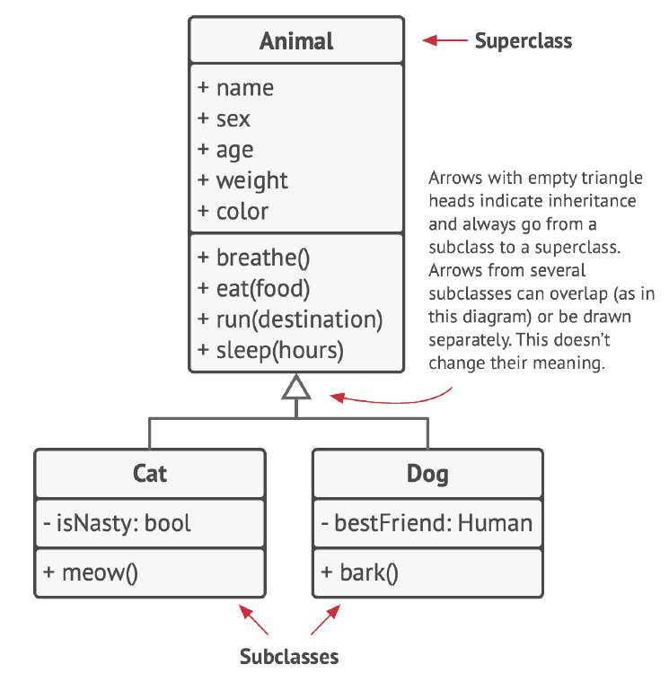
OMT – UML
Class hierarchies
some classes might be organized into class hierarchies
parent class, is called a superclass
its children are subclasses
subclasses inherit state and behavior from their parent, defining only attributes or behaviors that differ
the Cat class would have the meow
method, and the Dog class the bark method
Corso C#

Slide 17
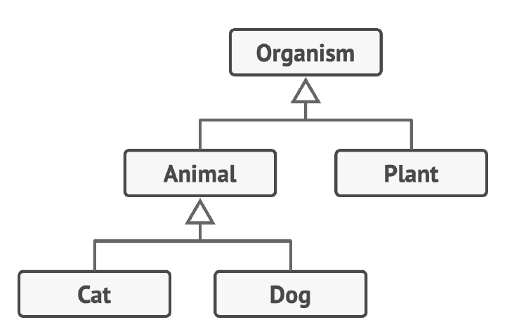
OMT – UML
Class hierarchies
we can go even further and extract a more general class for all living
Organisms which will become a superclass for Animals and Plants
Corso C#

Slide 18
OMT – UML
OOP Pillars
Abstraction is a model of a real-world object or phenomenon,
limited to a specific context, which represents all details relevant
to this context with high accuracy and omits all the rest
Encapsulation is the ability of an object to hide parts of its
state and behaviors from other objects, exposing only a limited
interface to the rest of the program
to encapsulate something means to make it private, and thus
accessible only from within the methods of its own class
there’s a little bit less restrictive mode called protected that
makes a member of a class available to subclasses as well
Corso C#

Slide 19
OMT – UML
OOP Pillars
interfaces and abstract classes/methods of most programming languages are based on the concepts of abstraction and encapsulation
in modern object-oriented programming languages, the interface mechanism (usually declared with the interface or protocol keyword) lets you define contracts of interaction between objects
that’s one of the reasons why the interfaces only care about behaviors of objects, and why you can’t declare a field in an interface
Corso C#

Slide 20
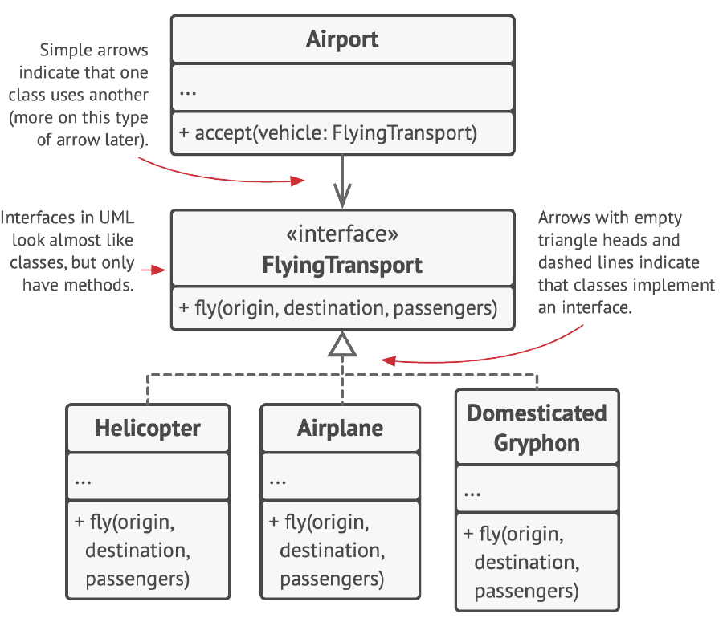
OMT – UML
OOP Pillars
we have a FlyingTransport interface with a method fly (origin, destination, passengers)
when designing an air transportation simulator, you could restrict the
Airport class to work only with objects that implement the
FlyingTransport interface
after this, you can be sure that any object passed to an airport object, whether it’s an Airplane , a
Helicopter or a DomesticatedGryphon would be able to arrive or depart from this type of airport
Corso C#

Slide 21
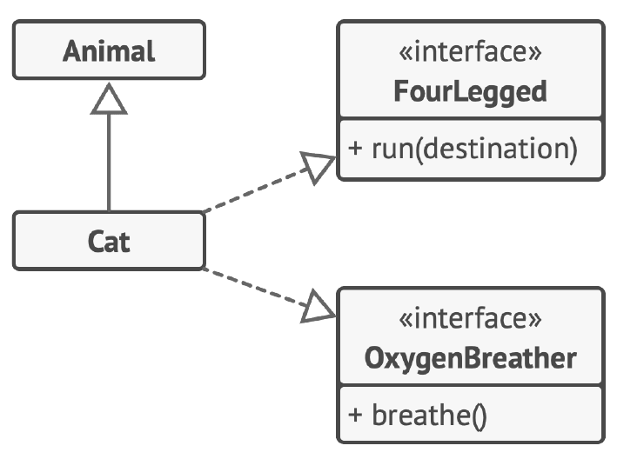
OMT – UML
OOP Pillars
Inheritance is the ability to build new classes on top of existing ones
the main benefit of inheritance is code reuse: if you want to create a class that’s slightly different from an existing
one, there’s no need to duplicate code
instead, you extend the existing class and put the extra functionality into a resulting subclass, which inherits fields and methods of the superclass
the consequence of using inheritance is that subclasses have the same interface as their parent class
you can’t hide a method in a subclass if it was declared in the superclass, you must also implement all abstract methods, even if they don’t make sense for your subclass
Cat extends Animal class and implements multiple interfaces at the same time
Corso C#

Slide 22
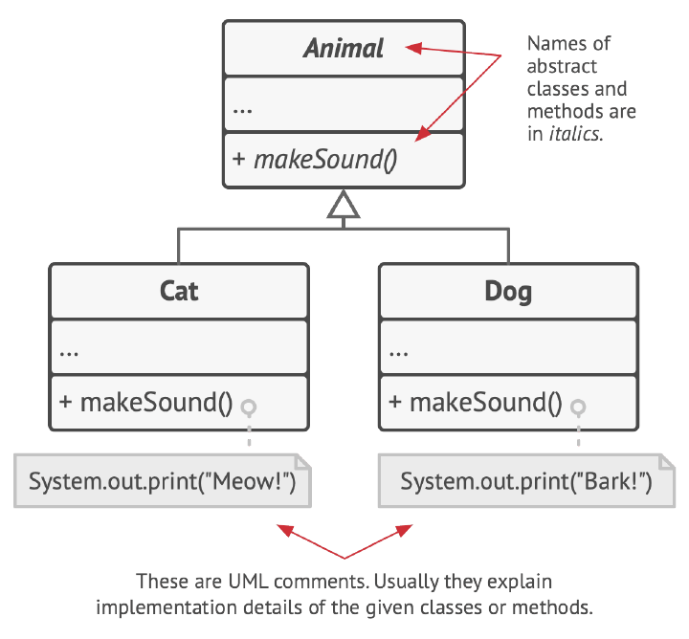
OMT – UML
OOP Pillars
Polymorphism is the ability of a program to detect the real class of an object and call its implementation even when its real type is unknown in the current context
myList = [new Cat(), new Dog()];
Foreach (Animal a in myList)
a.MakeSound();
// Meow!
// Woof!
the program doesn’t know the concrete type of the object contained inside the a variable but, thanks to the special mechanism
called polymorphism, the program can trace down the subclass of the object whose method is being executed and run the appropriate behavior
you can also think of polymorphism as the ability of an object to “pretend” to be something else, usually a class it extends or an interface it implements
in our example, the dogs and cats in myList were pretending to be generic animals
Corso C#

Slide 23
OMT – UML
Relations Between Objects
in addition to inheritance and implementation, there are other types of relations between objects:
Dependency
Association
Aggregation
Composition
Corso C#

Slide 24
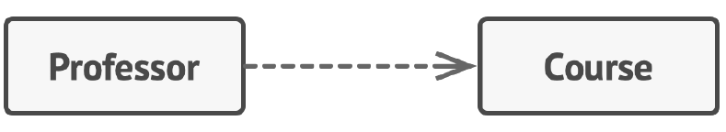
OMT – UML
Dependency
Dependency is the most basic and the weakest type of relations between two classes.
there is a dependency between two classes if some changes to the definition of one class might result in modifications to another class
Dependency typically occurs when you use concrete class names in your code: i.e. when specifying types in method signatures, when instantiating objects via constructor calls, or, to make a dependency weaker you make your code dependent on interfaces or abstract classes instead of concrete classes
usually, a UML diagram doesn’t show every dependency there are far too many of them in any real code
you should be very selective and show only those that are important to whatever it is you are communicating
Corso C#

Slide 25
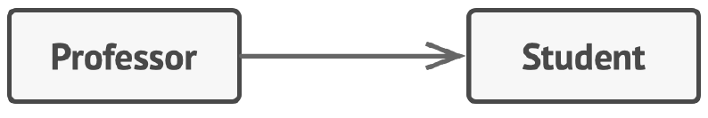
OMT – UML
Association
Association is a relationship in which one object uses or interacts with another
in UML diagrams, the association relationship is shown by a simple arrow drawn from an object and pointing to the object it uses
by the way, having a bi-directional association is a completely normal thing, in this case, the arrow has a point at each end
association can be seen as a specialized kind of dependency, where an object always has access to the objects with which it interacts
whereas simple dependency doesn’t establish a permanent link between objects
in general, you use an association to represent something like a field in a class
Corso C#

Slide 26
OMT – UML
Association
to solidify your understanding of the difference between association and dependency, let’s look at a combined example
Imagine that we have a Professor class
the Teach method takes an argument of the
Course class, which is then used in the body of the method
If someone changes the GetKnowledge method of the Course class (alters its name, or adds some required parameters, etc.) our code will break
this is called a dependency
class Professor
{
Student student;
void Teach(Course c)
{
student.Remember(c.GetKnowledge())
}
}
the Student class is also a dependency for the Professor: if the method Remember changes, the Professor’s code will break
however, since the student field is always accessible to any method of the Professor, the Student class is not just a dependency, but also an association.
Associations imply dependency
Corso C#

Slide 27
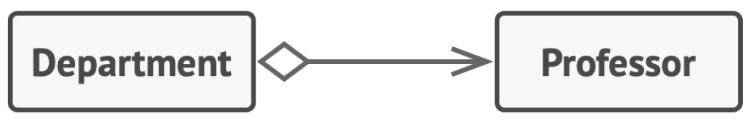
OMT – UML
Aggregation
Aggregation is a specialized type of association that represents “one-to-many”, “many-to-many” or “whole-part” relations between multiple objects
usually, under aggregation, an object “has” a set of other objects and serves as a container or collection
the component can exist without the container and can be linked to several containers at the same time
in UML the aggregation relationship is shown by a line with an empty diamond at the container end and an arrow at the end pointing toward the component
Corso C#

Slide 28
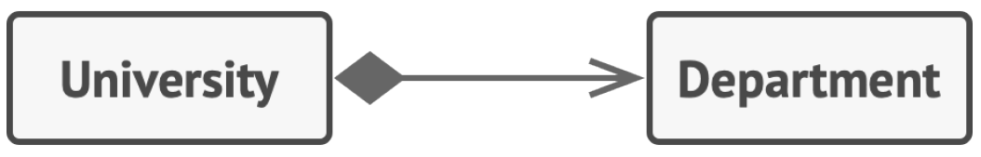
OMT – UML
Composition
Composition is a specific kind of aggregation, where one object is composed of one or more instances of the other
the distinction between this relation and others is that the component can only exist as a part of the container
in UML the composition relationship is drawn the same as for aggregation, but with a filled diamond at the arrow’s base
Note: many people often use the term “composition” when they really mean both the aggregation and composition
the most notorious example for this is the famous principle “choose composition over inheritance.”
it’s not because people are ignorant about the difference, but rather because the word “composition” (e.g. “object composition”) sounds more natural in the English language
Corso C#

Slide 29
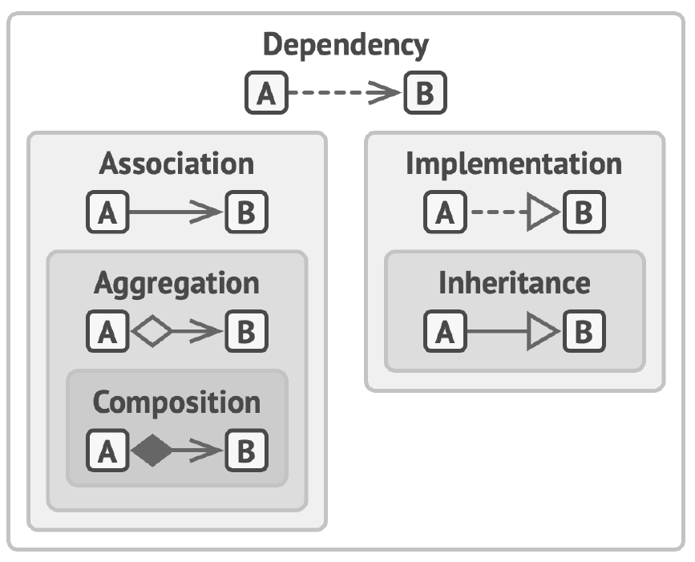
OMT – UML
Relations between objects and classes: from weakest to strongest
Dependency | Class А can be affected by changes in class B.
Association | Object А knows about object B. Class A depends on B.
Aggregation | Object А knows about object B, and consists of B. Class A depends on B
Composition | Object А knows about object B, consists of B, and manages B’s life cycle. Class A depends on B.
Implementation | Class А defines methods declared in interface B. Objects A can be treated as B. Class A depends on B.
Inheritance | Class А inherits interface and implementation of class B but can extend it Objects A can be treated as B. Class A depends on B
Corso C#

Slide 30
Software Design Principles
Good design
Code reuse is one of the most common ways to reduce development costs The intent is pretty obvious: instead of developing something over and over from scratch, why don’t we reuse existing code in new projects? But How? Class Library, Framework and, in the middle, Design Patterns
Extensibility in order to be ready for change: change is the only constant thing in a programmer’s life.
Corso C#

Slide 31
Software Design Principles
Design Principles
What is good software design? How would you measure it?
What practices would you need to follow to achieve it?
How can you make your architecture flexible, stable and easy to understand?
Encapsulate what varies
Program to an interface not an implementation
Favor composition over inheritance
Corso C#

Slide 32
Software Design Principles
Encapsulate what varies
Identify the aspects of your application that vary and separate them from what stays the same.
Encapsulation is breaking your application into different logical parts and then keeping those parts separate.
Ideally, a single change in requirements should lead to a single change in the code so the details should be put under a class, module or component that is going to centralize the varying logic.
// ❌ This is hard to understand
// and subject to change.
// We may need to check if a book is reserved.
function checkoutBook(customer, book) {
if (
customer &&
customer.fine <= 0.0 &&
customer.card &&
customer.card.expiration === null &&
book && !book.isCheckedOut
) {
customer.books.push(book)
book.isCheckedOut = true
}
return customer
}
// ✅ This is easy to read and
// won't change even if
// the checkout requirements vary.
function checkoutBook(customer, book) {
if (customer.canCheckout(book)) {
customer.checkout(book)
}
return customer
}
Corso C#

Slide 33
Software Design Principles
Encapsulate what varies – on method level
decimal GetOrderTotal(Order order)
{
var total = 0m;
foreach (var item in order.LineItems)
{
total += item.Price * item.Quantity;
}
if (order.Country == "US")
total += total * 0.07m; // US sales tax
else if (order.Country == "IT")
total += total * 0.22m; // Italian VAT
return total;
}
you can extract the tax calculation logic into a separate method, hiding it from the original method
decimal GetOrderTotal(Order order)
{
var total = 0m;
foreach (var item in order.LineItems)
{
total += item.Price * item.Quantity;
}
total += total * GetTaxRate(order.Country);
return total;
}
decimal GetTaxRate(string country)
{
if (country == "US")
return 0.07m; // US sales tax
if (country == "IT")
return 0.22m; // Italian VAT
return 0;
}
Corso C#

Slide 34
Software Design Principles
Encapsulate what varies – on class level
over time you might add more and more responsibilities to a method which used to do a simple thing
these added behaviors often come with their own helper fields and methods that eventually blur the primary responsibility of the containing class
extracting everything to a new class might make things much more clear and simple
Corso C#

Slide 35
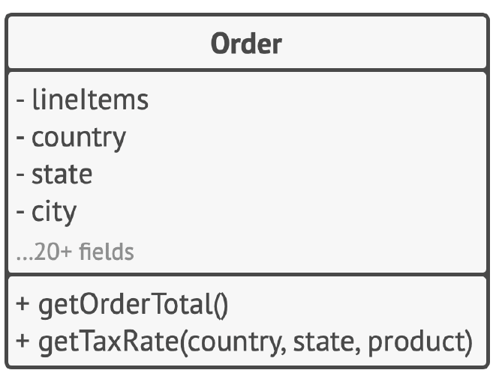
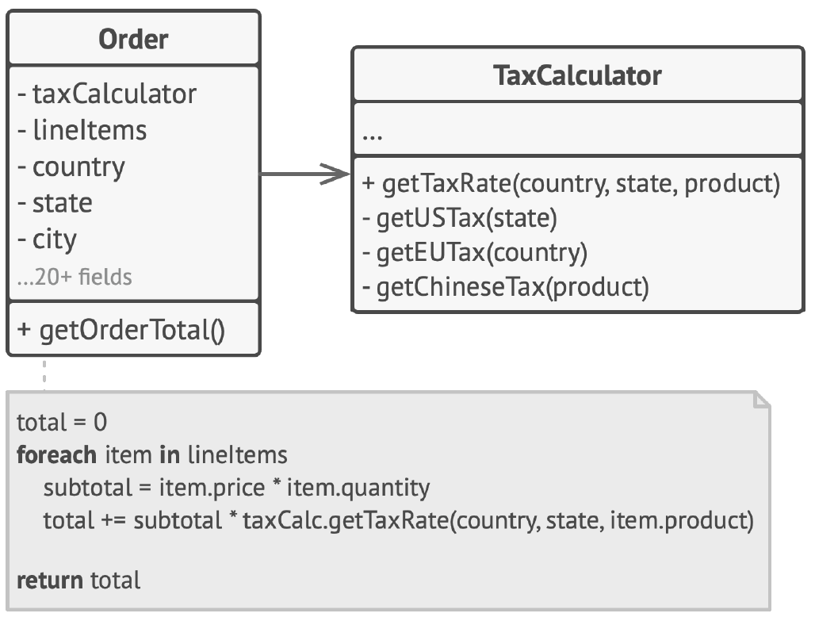
Software Design Principles
Encapsulate what varies – on class level
BEFORE: calculating tax in Order class
AFTER: tax calculation is hidden from the Order class
objects of the Order class delegate
all tax-related work to a special object
that does just that
Corso C#

Slide 36
Software Design Principles
Program to an interface not an implementation
Program to an interface, not an implementation
saying with different words
Depend on abstractions, not on concrete classes
Corso C#

Slide 37
Software Design Principles
Program to an interface not an implementation
you can tell that the design is flexible enough if you can easily extend it without breaking any existing code
when you want to make two classes collaborate, you can start by making one of them dependent on the other However, there’s another, more flexible way to set up collaboration between objects:
1. Determine what exactly one object needs from the other: which methods does it execute?
2. Describe these methods in a new interface or abstract class
3. Make the class that is a dependency implement this interface
4. Now make the second class dependent on this interface rather than on the concrete class
you still can make it work with objects of the original class, but the connection is now much more flexible
Corso C#

Slide 38
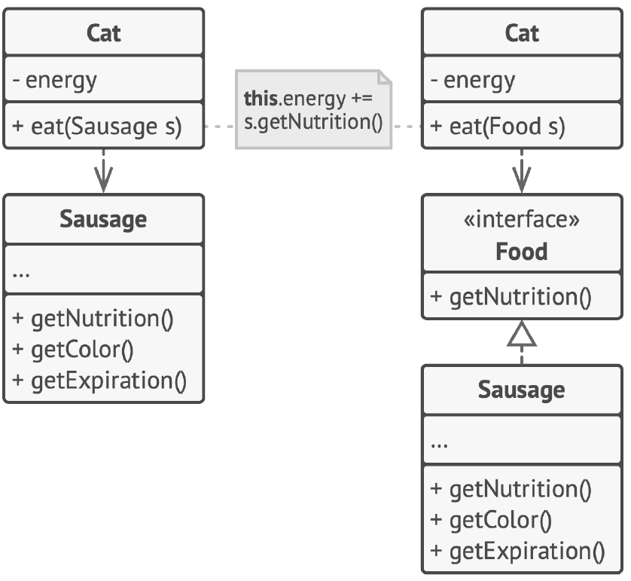
Software Design Principles
Program to an interface not an implementation
before and after extracting the interface
the code on the right is more flexible than the code on the left, but it’s also more complicated
working with objects through interfaces might be more beneficial than depending on their concrete classes
Corso C#

Slide 39
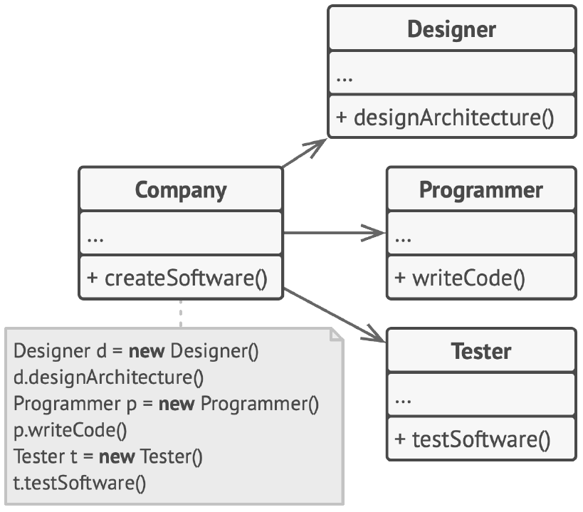
Software Design Principles
Program to an interface not an implementation
BEFORE: all classes are tightly coupled
in the beginning, the Company class is tightly coupled to concrete classes of employees However, despite the difference in their implementations, we can generalize various work-related methods and then extract a common interface for all employee classes
Corso C#

Slide 40
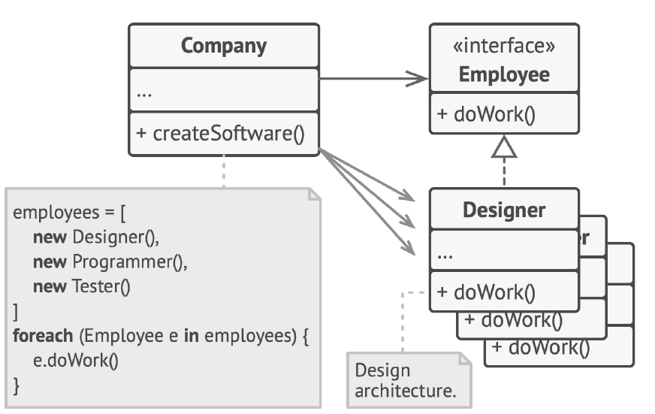
Software Design Principles
Program to an interface not an implementation
BETTER: polymorphism helped us simplify the code, but the rest of the Company class still depends on the concrete employee classes
the Company class remains coupled to the employee classes
this is bad because if we introduce new types of companies that work with other types of employees, we’ll need to override most of the Company class instead of reusing that code
Corso C#

Slide 41
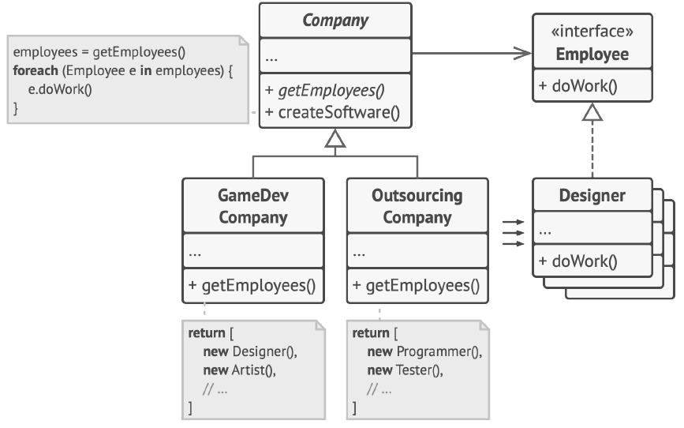
Software Design Principles
Program to an interface not an implementation
AFTER: the primary method of the Company class is independent from concrete employee classes
employee objects are created in concrete company subclasses
declaring the method for getting employees as abstract. Each concrete company will implement this method differently, creating only those employees that it needs
after this change, the Company class has become independent from various employee classes now you can extend this class, introduce new types of companies and employees while still reusing a portion of the base company class extending the base company class doesn’t break any existing code that already relies on it
Corso C#

Slide 42
Software Design Principles
Favor composition over inheritance
inheritance is probably the most obvious and easy way of reusing code between classes:
you have two classes with the same code
you create a common base class for these two and move the similar code into it
easy!
Unfortunately, inheritance comes with caveats that often become apparent only after your program already has tons of classes and changing anything is pretty hard
Corso C#

Slide 43
Software Design Principles
Favor composition over inheritance
a subclass can’t reduce the interface of the superclass: you must implement all abstract methods of the parent class even if you won’t be using them
when overriding methods you need to make sure that the new behavior is compatible with the base one: it’s important because objects of the subclass may be passed to any code that expects objects of the superclass and you don’t want that code to break
inheritance breaks encapsulation of the superclass because the internal details of the parent class become available to the subclass: there might be an opposite situation where a programmer makes a superclass aware of some details of subclasses for the sake of making further extension easier
subclasses are tightly coupled to superclasses: any change in a superclass may break the functionality of subclasses
trying to reuse code through inheritance can lead to creating parallel inheritance hierarchies; inheritance usually takes place in a single dimension, but whenever there are two or more dimensions, you have to create lots of class combinations, bloating the class hierarchy to a ridiculous size
Corso C#

Slide 44
Software Design Principles
Favor composition over inheritance
There’s an alternative to inheritance called composition.
inheritance represents the “is a” relationship between classes (a car is a transport)
composition represents the “has a” relationship (a car has an engine)
I should mention that this principle also applies to aggregation, a more relaxed variant of composition where one object may have a reference to the other one but doesn’t manage its lifecycle: a car has a driver, but he or she may use another car or just walk without the car.
Corso C#

Slide 45
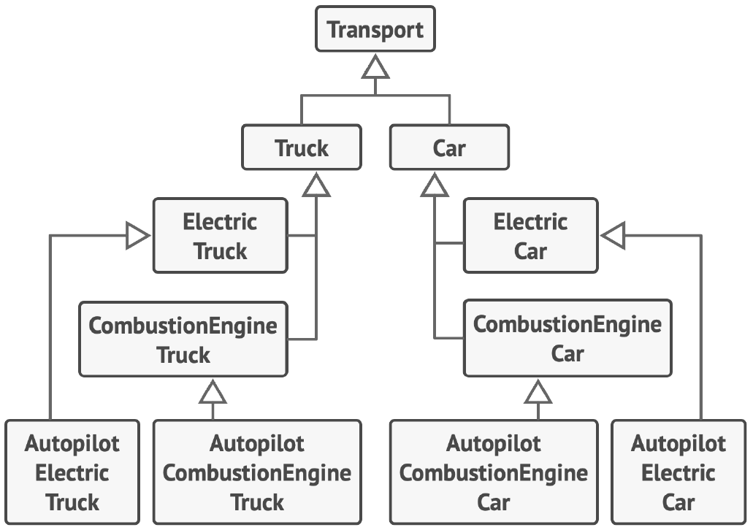
Software Design Principles
Favor composition over inheritance
Imagine that you need to create a catalog app for a car manufacturer
the company makes both cars and trucks;
they can be either electric or gas;
all models have either manual controls or an autopilot
with Inheritance extending a class in several dimensions (cargo type × engine type × navigation type) may lead to a combinatorial explosion of subclasses
each additional parameter results in multiplying the number of subclasses
there’s a lot of duplicate code between subclasses because a subclass can’t extend two classes at the same time
Corso C#

Slide 46
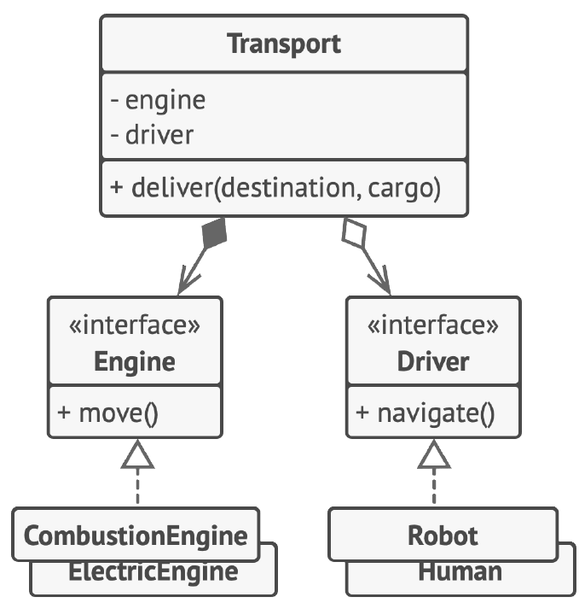
Software Design Principles
Favor composition over inheritance
you can solve this problem with composition: instead of car objects implementing a behavior on their own, they can delegate it to other objects
the added benefit is that you can replace a behavior at runtime
i.e. you can replace an engine object linked to a car object just by assigning a different engine object to the car
Corso C#

Slide 47
Solid Principles
Solid Principles
SOLID is a mnemonic for five design principles intended to make software designs more understandable, flexible and maintainable
as with everything in life, using these principles mindlessly can cause more harm than good
the cost of applying these principles into a program’s architecture might be making it more complicated than it should be
it’s hard to see a software product in which all of these principles are applied at the same time
striving for these principles is good, but always try to be pragmatic and don’t take everything written here as dogma
S – SRP – Single Responsibility Principle O – OCP – Open Close Principle L – LSP – Liskov Substitution Principle I – ISP – Interface Segregation Principle D – DIP – Dependency Inversion Principle
Corso C#

Slide 48
Solid Principles
Single Responsibility Principle
a class should have just one reason to change
every class must be responsible for a single part of the functionality provided by the software,
that responsibility must be entirely encapsulated by (you can also say hidden within) the class
every method must be responsible for a single action
when the software grows and you feel that it’s becoming hard to focus on specific aspects of the program one at a time, remember the single responsibility principle and check whether it’s time to divide some classes or methods into parts
more in general: a class should have only one reason to change
Corso C#

Slide 49
Solid Principles
Single Responsibility Principle – Example 1
consider a class that compiles and prints a report
imagine such a class can be changed for two reasons:
the content of the report could change
the format of the report could change
these two things change for different causes
the single-responsibility principle says that these two aspects of the problem are really two separate responsibilities, and should, therefore, be in separate classes or modules
it would be a bad design to couple two things that change for different reasons at different times.
Corso C#

Slide 50
Solid Principles
Single Responsibility Principle – Example 2
Employee class has several reasons to change. The first reason might be related to the main job of the class: managing employee data. However, there’s another reason: the format of the timesheet report may change over time, requiring you to change the code within the class.
Employee
- name
+ getName() + printTimeSheetReport()
the class contains several different behaviors
solve the problem by moving the behavior related to printing timesheet reports into a separate class
this change lets you move other report-related stuff to the new class
TimeSheetReport
…
+ print(employee)
Employee
- name
+ getName()
the extra behavior is in its own class
Corso C#

Slide 51
Solid Principles
Open Close Principle
classes should be open for extension but closed for modification
if a class is already developed, tested, reviewed, and included in some framework or otherwise used in an app, trying to mess with its code is risky
instead of changing the code of the class directly, you can create a subclass and override parts of the original class that you want to behave differently
you’ll achieve your goal but also won’t break any existing clients of the original class
this principle isn’t meant to be applied for all changes to a class: i.e. if you know that there’s a bug in the class, just go on and fix it; don’t create a subclass for it. A child class shouldn’t be responsible for the parent’s issues
A class is closed, since it may be compiled, stored in a library, baselined, and used by client classes. But it is also open, since any new class may use it as parent, adding new features. When a descendant class is defined, there is no need to change the original or to disturb its clients.
Corso C#

Slide 52
Solid Principles
Open Close Principle - Example
you have an e-commerce application with an Order class that calculates shipping costs and all shipping methods are hardcoded inside the class
if you need to add a new shipping method, you have to change the code of the Order class and risk breaking it
Order
- lineItems - shipping
+ getTotal() + getTotalWeight() + getShippingType(st) + getShippingCost() + getShippingDate()
if (shipping == “ground” {
if (getTotal() > 100 {
return 0;
}
return max (10, getTotalWeight() * 1.5)
}
if (shipping == “air” {
return max(20, getTotalWeight() *3)
}
you have to change the Order class whenever you add a new
shipping method to the app
Corso C#

Slide 53
Solid Principles
Open Close Principle - Example
you can solve the problem by applying the Strategy pattern: start by extracting shipping methods into separate classes with a common interface
adding a new shipping method doesn’t require changing existing classes
Order
- lineItems - shipping: IShipping
+ getTotal() + getTotalWeight() + getShippingType(shipping) + getShippingCost() + getShippingDate()
now when you need to implement a new shipping method, you
can derive a new class from the IShipping interface without
touching any of the Order class’ code
The client code of the
Order class will link orders with a shipping object of the new
class whenever the user selects this shipping methods in the UI
as a bonus, this solution let you move the delivery time calculation
to more relevant classes, according to the single responsibility
principle
<<interface>> IShipping
+ getCost(Order) + getDate(Order)
return shipping.GetCost(this)
Ground
…
+ getCost(order) + getDate(order)
Air
…
+ getCost(order) + getDate(order)
if (order.getTotal() > 100 {
return 0;
}
return max (10, order.getTotalWeight() * 1.5)
Corso C#

Slide 54
Solid Principles
Liskov Substitution Principle
when extending a class, remember that you should be able to pass objects of the subclass in place of objects of the parent class without breaking the client code
the subclass should remain compatible with the behavior of the superclass: when overriding a method, extend the base behavior rather than replacing it with something else entirely
is a set of checks that help predict whether a subclass remains compatible with the code that was able to work with objects of the superclass
unlike other design principles which are wide open for interpretation, the substitution principle has a set of formal requirements for subclasses, and specifically for their methods
Corso C#

Slide 55
Solid Principles
Liskov Substitution Principle – checklist 1
Parameter types in a method of a subclass should match or be more abstract than parameter types in the method of the superclass
a class with a method that’s supposed to feed cats: feed(Cat c): client code always passes Cat objects into this method
GOOD: you create a subclass that override the method so that it can feed any animal (a superclass of cats): feed(Animal c) Now if you pass an object of this subclass instead of an object of the superclass to the client code, everything would still work fine the method can feed all animals, so it can still feed any cat passed by the client
BAD: you create another subclass and restricted the feeding method to only accept Bengal cats (a subclass of cats): feed(BengalCat c) What will happen to the client code if you link it with an object like this instead of with the original class? Since the method can only feed a specific breed of cats, it won’t serve generic cats passed by the client, breaking all related functionality
Contravariance of method parameter types in the subtype
Corso C#

Slide 56
Solid Principles
Liskov Substitution Principle – checklist 2
Return type in a method of a subclass should match or be a subtype of the return type in the method of the superclass: as you can see, requirements for a return type are inverse to requirements for parameter types
you have a class with a method buyCat() : Cat. The client code expects to receive any cat as a result of executing this method
GOOD: a subclass overrides the method as follows: buyCat(): BengalCat the client gets a Bengal cat, which is still a cat, so everything is okay
BAD: a subclass overrides the method as follows: buyCat(): Animal the client code breaks since it receives an unknown generic animal (an alligator? a bear?) that doesn’t fit a structure designed for a cat
Covariance of method return types in the subtype
Corso C#

Slide 57
Solid Principles
Liskov Substitution Principle – checklist 3
A method in a subclass shouldn’t throw types of exceptions which the base method isn’t expected to throw
in other words, types of exceptions should match or be subtypes of the ones that the base method is already able to throw
this rule comes from the fact that try-catch blocks in the client code target specific types of exceptions which the base method is likely to throw: therefore, an unexpected exception might slip through the defensive lines of the client code and crash the entire application.
New exceptions cannot be thrown by the methods in the subtype, except if they are subtypes of exceptions thrown by the methods of the supertype
NOTE: in most modern programming languages, especially statically typed ones (Java, C#, and others), these rules are built into the language
you won’t be able to compile a program that violates these rules
Corso C#

Slide 58
Solid Principles
Liskov Substitution Principle – checklist 4
a subclass shouldn’t strengthen pre-conditions
for example, the base method has a parameter with type int
if a subclass overrides this method and requires that the value of an argument passed to the method should be positive (by throwing an exception if the value is negative), this strengthens the pre-conditions
the client code, which used to work fine when passing negative numbers into the method, now breaks if it starts working with an object of this subclass
Preconditions cannot be strengthened in the subtype
Corso C#

Slide 59
Solid Principles
Liskov Substitution Principle – checklist 5
a subclass shouldn’t weaken post-conditions
say you have a class with a method that works with a database
a method of the class is supposed to always close all opened database connections upon returning a value
you created a subclass and changed it so that database connections remain open so you can reuse them
but the client might not know anything about your intentions: because it expects the methods to close all the connections, it may simply terminate the program right after calling the method, polluting a system with ghost database connections
Postconditions cannot be weakened in the subtype
Corso C#

Slide 60
Solid Principles
Liskov Substitution Principle – checklist 6
Invariants of a superclass must be preserved
this is probably the least formal rule of all
invariants are conditions in which an object makes sense
for example, invariants of a Cat are having four legs, a tail, ability to meow, etc; the confusing part about invariants is that while they can be defined explicitly in the form of interface contracts or a set of assertions within methods, they could also be implied by certain unit tests and expectations of the client code
the rule on invariants is the easiest to violate because you might misunderstand or not realize all of the invariants of a complex class therefore, the safest way to extend a class is to introduce new fields and methods, and not mess with any existing members of the superclass of course, that’s not always doable in real life.
Invariants must be preserved in the subtype
Corso C#

Slide 61
Solid Principles
Liskov Substitution Principle – checklist 7
a subclass shouldn’t change values of private fields of the superclass
What? How’s that even possible? it turns out some programming languages let you access private members of a class via reflection mechanisms other languages (Python, JavaScript) don’t have any protection for the private members at all
objects are regarded as being modifiable only through their methods (encapsulation)
because subtypes may introduce methods that are not present in the supertype, the introduction of these methods may allow state changes in the subtype that are not permissible in the supertype: the history constraint prohibits this
History constraint (the "history rule")
Corso C#

Slide 62
Solid Principles
Liskov Substitution Principle – example
Let’s look at an example of a hierarchy of document classes that violates the substitution principle
Document
- data - filename
+ open() + save()
Project
- documents
+ openAll() + saveAll()
the save() method in the ReadOnlyDocuments subclass throws an exception if someone tries to call it the base method doesn’t have this restriction: this means that the client code will break if we don’t check the document type before saving it
the resulting code also violates the open/closed principle, since the client code becomes dependent on concrete classes
of documents: if you introduce a new document subclass, you’ll need to change the client code to support it
foreach (doc in documents) {
doc.open()
}
foreach (doc in documents) {
if(!doc instanceof(ReadOnlyDocument) {
doc.Save()
}
}
ReadOnlyDocument
+ save()
Throw new Exception (“Unable to save read-only file.”)
saving doesn’t make sense in a read-only document, so the subclass tries to solve it by resetting the base behavior in the overridden method
Corso C#

Slide 63
Solid Principles
Liskov Substitution Principle – example
Let’s look at an example of a hierarchy of document classes that violates the substitution principle
Document
- data - filename
+ open()
Project
- allDocs - writableDocuments
+ openAll() + saveAll()
you can solve the problem by redesigning the class hierarchy:
a subclass should extend the behavior of a superclass, therefore the read-only document becomes the base class of the hierarchy
the writable document is now a subclass which extends the base class and adds the saving behavior
foreach (doc in allDocs) {
doc.open()
}
WritableDocument
+ save()
foreach (doc in writableDocs) {
doc.Save()
}
the problem is solved after making the read-only document class the base class of the hierarchy
Corso C#

Slide 64
Solid Principles
Interface Segregation Principle
Clients should not be forced to depend on methods they do not use
try to make your interfaces narrow enough that client classes don’t have to implement behaviors they don’t need
according to the interface segregation principle, you should break down “fat” interfaces into more granular and specific ones
clients should implement only those methods that they really need, otherwise, a change to a “fat” interface would break even clients that don’t use the changed methods
class inheritance lets a class have just one superclass, but it doesn’t limit the number of interfaces that the class can implement at the same time; hence, there’s no need to cram tons of unrelated methods to a single interface: break it down into several more refined interfaces - you can implement them all in a single class if needed however, some classes may be fine with implementing just one of them
Corso C#

Slide 65
Solid Principles
Interface Segregation Principle – example
you created a library that makes it easy to integrate apps with various cloud computing providers
while in the initial version it only supported Amazon Cloud, it covered the full set of cloud services and features
at the time you assumed that all cloud providers have the same broad spectrum of features as Amazon
Corso C#

Slide 66
Solid Principles
Interface Segregation Principle – example
then it came to implementing support for another provider, it turned out that most of the interfaces of the library are too wide: some methods describe features that other cloud providers just don’t have
<<interface>> ICloudProvider
+ storeFile(name) + getFile(name) + createServer(region) + listServers(region) + getCDNAddress()
while you can still implement these methods and put some stubs there, it wouldn’t be a pretty solution
Amazon
…
+ storeFile(name) + getFile(name) + createServer(region) + listServers(region) + getCDNAddress()
Dropbox
…
+ storeFile(name) + getFile(name) + createServer(region) + listServers(region) + getCDNAddress()
not all clients can satisfy the requirements of the interface
Not implemented
Corso C#

Slide 67
Solid Principles
Interface Segregation Principle – example
the better approach is to break down the interface into parts: classes that are able to implement the original interface can now just implement several refined interfaces.
other classes can implement only those interfaces which have methods that make sense for them
<<interface>> ICloudHostingProvider
+ createServer(region) + listServers(region)
<<interface>> ICDNProvider
+ getCDNAddress()
<<interface>> ICloudStorageProvider
+ storeFile(name) + getFile(name)
one bloated interface is broken down into a set of more
granular interfaces
as with the other principles, you can go too far with this one don’t further divide an interface which is already quite specific. remember that the more interfaces you create, the more complex your code becomes
Keep the balance
Amazon
…
+ storeFile(name) + getFile(name) + createServer(region) + listServers(region) + getCDNAddress()
Dropbox
…
+ storeFile(name) + getFile(name)
Corso C#

Slide 68
Solid Principles
Dependency Inversion Principle
High-level classes should not depend on low-level classes. Both should depend on abstractions (i.e. interfaces) Abstractions should not depend on details. Details (concrete implementations) should depend on abstractions
Usually when designing software, you can make a distinction between two levels of classes:
Low-level classes implement basic operations such as working with a disk, transferring data over a network, connecting to a database, etc.
High-level classes contain complex business logic that directs low-level classes to do something
Sometimes people design low-level classes first and only then start working on high-level ones This is very common when you start developing a prototype on a new system, and you’re not even sure what’s possible at the higher level because low-level stuff isn’t yet implemented or clear With such an approach business logic classes tend to become dependent on primitive low-level classes
The dependency inversion principle suggests changing the direction of this dependency.
Corso C#

Slide 69
Solid Principles
Dependency Inversion Principle
For starters, you need to describe interfaces for low-level operations that high-level classes rely on, preferably in business terms. For instance, business logic should call a method openReport(file) rather than a series of methods openFile(x), readBytes(n), closeFile(x). These interfaces count as high-level ones.
Now you can make high-level classes dependent on those interfaces, instead of on concrete low-level classes. This dependency will be much softer than the original one.
Once low-level classes implement these interfaces, they become dependent on the business logic level, reversing the direction of the original dependency
The dependency inversion principle often goes along with the open/closed principle: you can extend low-level classes to use with different business logic classes without breaking existing classes.
Corso C#

Slide 70
Solid Principles
Dependency Inversion Principle - example
the high-level budget reporting class uses a low-level database class for reading and persisting its data
this means that any change in the low-level class, such as when a new version of the database server gets released, may affect the high-level class, which isn’t supposed to care about the data storage details
High level
Low level
a high-level class depends on a low-level class
MySQLDatabase
…
+ insert() + update() + delete()
BudgetReport
- database
+ open(date) + save()
Corso C#

Slide 71
Solid Principles
Dependency Inversion Principle - example
you can fix this problem by creating a high-level interface that describes read/write operations and making the reporting class use that interface instead of the low-level class
then you can change or extend the original low-level class to implement the new read/write interface declared by the business logic.
High level
Abstraction
low-level classes depend on a high-level abstraction
BudgetReport
- database
+ open(date) + save()
<<interface> IDatabase
+ insert() + update() + delete()
as a result, the direction of the original dependency has been inverted: low-level classes are now dependent on high-level abstractions
MySQLDatabase
…
+ insert() + update() + delete()
MongoDB
…
+ insert() + update() + delete()
MSSqlServerDB
…
+ insert() + update() + delete()
Low level
Corso C#

Slide 72
Design Patterns
Intro
a software design pattern is a general, reusable solution to a commonly occurring problem within a given context in software design
it is not a finished design that can be transformed directly into source or machine code; rather, it is a description or template for how to solve a problem that can be used in many different situations
design patterns are formalized best practices that the programmer can use to solve common problems when designing an application or system
Corso C#

Slide 73
Design Patterns
Classification
Design patterns had originally been categorized into 3 sub-classifications based on what kind of problem they solve:
creational patterns provide the capability to create objects based on a required criterion and in a controlled way
structural patterns are about organizing different classes and objects to form larger structures and provide new functionality
behavioral patterns are about identifying common communication patterns between objects and realizing these patterns
Corso C#

Slide 74
Design Patterns
Creational Design Patterns
Creational design patterns provide various object creation mechanisms, which increase flexibility and reuse of existing code.
Factory Method: provides an interface for creating objects in a superclass, but allows subclasses to alter the type of objects that will be created
Abstract Factory: lets you produce families of related objects without specifying their concrete classes
Builder: lets you construct complex objects step by step; the pattern allows you to produce different types and representations of an objects using the same construction code.
Prototype: lets you copy existing objects without making your code dependent on their classes.
Singleton: lets you ensure that a class has only one instance while providing a global access point to this instance.
Corso C#

Slide 75
Design Patterns
Structural Design Patterns
Structural design patterns explain how to assemble objects and classes into larger structures, while keeping these structures flexible and efficient.
Adapter: allows objects with incompatible interfaces to collaborate
Bridge: lets you split a large class or a set of closely related classes into two separate hierarchies – abstraction and implementation – which can be developed independently of each other
Composite: lets you compose objects into tree structures and then work with these structures as if they were individual objects
Decorator: lets you attach new behaviors to objects by placing these objects inside special wrapper objects that contain the behavior
Corso C#

Slide 76
Design Patterns
Structural Design Patterns
Structural design patterns explain how to assemble objects and classes into larger structures, while keeping these structures flexible and efficient.
Façade: provides a simplified interface to a library, a framework, or any other complex set of classes
Flyweight: lets you fit more objects into the available amount of RAM by sharing common parts of state between multiple objects instead of keeping all of the data in each object
Proxy: lets you provide a substitute or placeholder for another object. A proxy controls access to the original object, allowing you to perform something either before or after the request gets through to the original object
Corso C#

Slide 77
Design Patterns
Behavioral Design Patterns
Behavioral design patterns are concerned with algorithms and the assignment of responsibilities between objects.
Chain of responsibility: lets you pass requests along a chain of handlers. Upon receiving a request, each handler decides either to process the request or to pass it to the next handler in the chain
Command: turns a request into a stand-alone object that contains all information about the request. This transformation lets you pass requests as a method arguments, delay or queue a request’s execution, and support undoable operations
Iterator: lets you traverse elements of a collection without exposing its underlying representation (list, stack, tree, etc.)
Mediator: lets you reduce chaotic dependencies between objects. The pattern restricts direct communications between the objects and forces them to collaborate only via a mediator object
Memento: lets you save and restore the previous state of an object without revealing the details of its implementation
Corso C#

